Slide 1


Global Superstore Sales

Slide 2
Process
1
Data Collection
2
Data Understanding
3
Data Cleaning
4
Data Visualization
5
Uncover Insights

Slide 3

Data Overview
Data Source:
Global superstore sales dataset (scrapped from the Kaggle)
Total Records:
51,290 Rows
Key Columns Used:
Category: The category of products sold in the superstore.
Order date: The date when the order was placed.
Profit: The profit generated from the order.
Region: The region where the order was placed.
Sales: The total sales amount for the order.

Slide 4
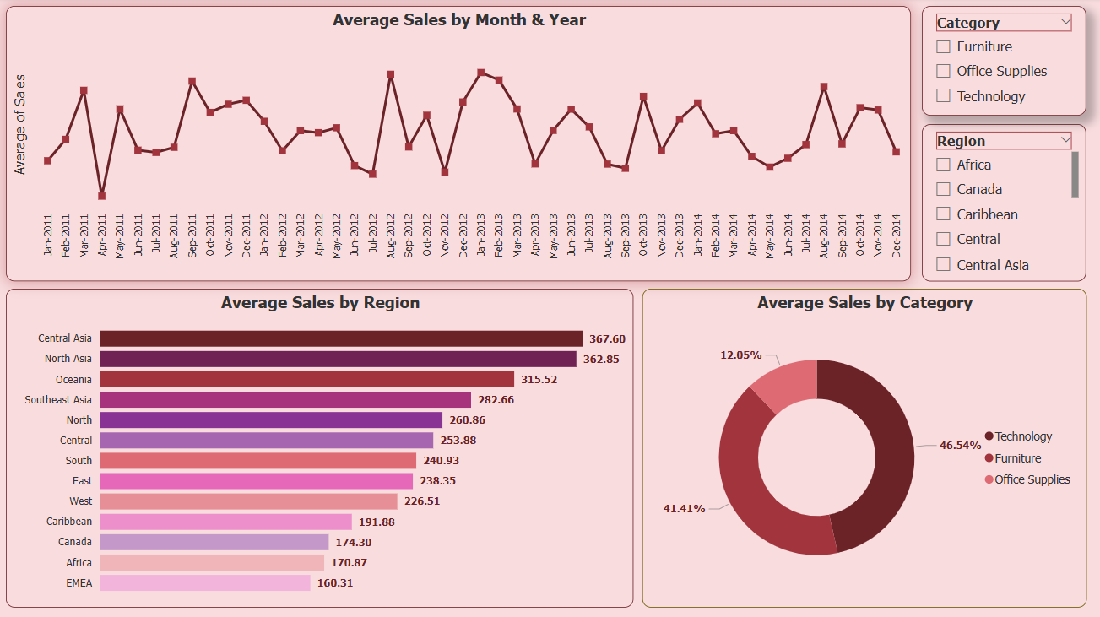
Insights

Slide 5

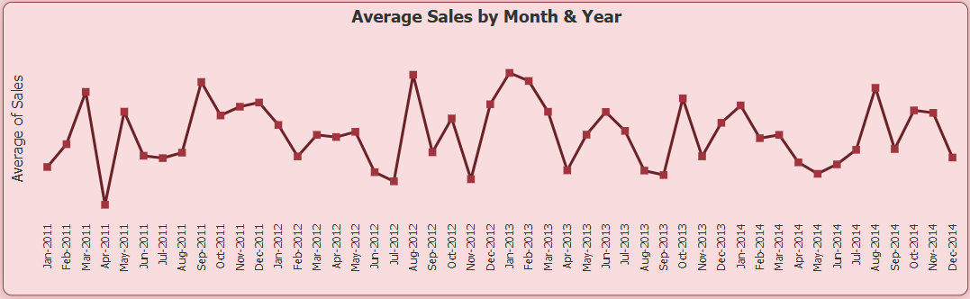
Monthly Sales Trend Analysis
Seasonal Trends:
The sales data reveals a clear pattern where dips are consistent in April and October. This suggests a seasonal effect, possibly influenced by market demand, holidays, or industry cycles.
Cyclical Behavior:
The fluctuations in sales follow a predictable cycle, indicating that businesses can anticipate high and low sales periods and plan accordingly.
Strategic Opportunities:
Leveraging high-sales months for marketing campaigns and product launches could maximize revenue. Similarly, businesses can introduce promotions or alternative strategies to mitigate losses during low-sales months.
Forecasting Potential:
By recognizing these patterns, businesses can develop more precise sales forecasts, ensuring better resource allocation and inventory management.

Slide 6

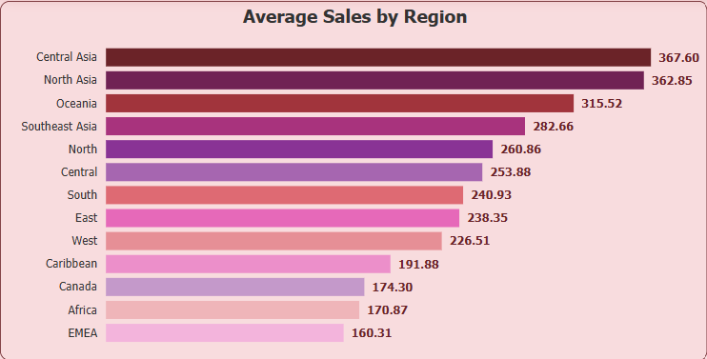
Regional Sales
Top Performing Regions: Central Asia and North Asia lead the pack with the highest average sales, at 367.60 and 362.85, respectively. These regions could be driving strong market demand or benefiting from favorable business conditions.
Strong Mid-tier Markets: Oceania, Southeast Asia, and the North region show solid sales performance, ranging from 315.52 to 260.86. This suggests a steady market presence that may be ripe for expansion strategies.
Lower Sales Regions: Africa and EMEA report the lowest average sales, at 170.87 and 160.31. This indicates potential challenges in market penetration, economic conditions, or competitive dynamics in these areas.
Strategic Takeaway: Companies can focus on reinforcing success in high-performing regions, while exploring ways to boost sales in underperforming markets through better marketing, partnerships, or localized strategies.

Slide 7
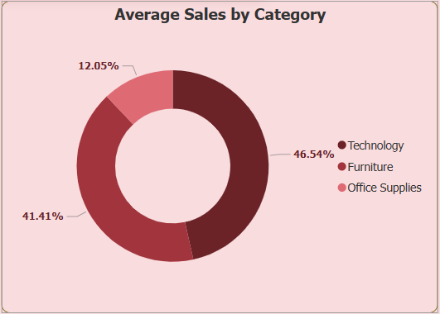
Categorical Sales
Top-Performing Category: Technology leads with 46.54% of total sales, making it the most significant contributor. This suggests a strong demand for tech-related products, driving revenue.
Furniture as a Close Second: The Furniture category accounts for 41.41%, meaning it's nearly as influential as Technology. Businesses may find opportunities for growth by enhancing offerings or optimizing pricing strategies.
Office Supplies Lag Behind: With only 12.05% of sales, Office Supplies contribute the least. This could indicate a lower demand or a need for better marketing and distribution strategies to boost sales.
Strategic Implications: Prioritizing investment and marketing efforts in Technology and Furniture can maximize revenue. Meanwhile, strategies to revive Office Supplies could include bundling, promotions, or expanding product lines.

Slide 8


Sales Over Time (Sales and Month-Year): Sales exhibit clear seasonal trends with regular peaks and dips, highlighting predictable cycles. This pattern can guide sales forecasting, marketing timing, and resource allocation.
Sales by Region (Region and Sales): Central Asia and North Asia dominate with the highest sales, while Africa and EMEA lag behind. Businesses can focus on reinforcing success in high-performing regions while exploring strategies to improve sales in underperforming areas.
Sales by Category (Category and Sales): Technology and Furniture contribute the most to sales, collectively making up over 87% of the total. Office Supplies lag significantly, suggesting a need for targeted strategies to boost this category’s performance.
In summary, these insights collectively emphasize the importance of leveraging historical data to drive strategic decisions like optimizing operations during peak times, tailoring marketing strategies to specific regions, and prioritizing high-performing categories for maximum impact.
Summary

Slide 9

Thank you!
ANY QUESTIONS?

